Slide 1

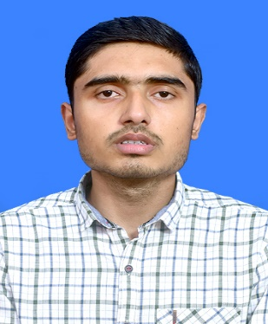



Aditya Kumar Jha
Education and certificates
Bachelor of Technology Mechanical Engineering: 2018 - 2022
Senior Analyst/Software Engineer
Technical Skills
Java
Python
Machine learning
Base Location: Bangalore
Email ID:
aditya-kumar.a.jha@capgemini.com
_{Mobile No:} +91 6378653147
Grade:
A5
Integration Tools
Webmethods
Dell Boomi
Database
SQL
Strengths
Certified Associate integration Developer and Certified Professional Integration Developer.
Has working knowledge on Webmethods Integration platform.
Ready to learn new technologies/Frameworks and implement them to further improve my knowledge.
Passionate about implementing and launching new projects.
A team player with good communication skill always ready to work for the enrichment of knowledge.
Skills & Experience Summary
Aditya is a 2022 graduated fresher with bachelor’s degree in Mechanical Engineering and having proficiency in Java , Python and machine learning (basics).
A machine learning unsupervised model for detecting the sleep quality.
Trained in Integration foundations with Dell Boomi.
Currently deployed in Webmethods operations team for GE Aerospace.
Competencies
Having Knowledge on Data Structure and Algorithm and object-oriented programming.
Acquired fundamental knowledge of Integration Essentials and principles.
Additional Details
Good Communication Skills
Team Player
Presentation Title | Author | Date © Capgemini 2017. All rights reserved | 1

